Slide 1

Machine Learning (机器学习)-Regression
Prof.Shuyuan Yang, Zhixi Feng
E-mail： syyang@xidianedu.cn
zxfeng@xidian.edu.cn

Slide 2
Contents
From Linear to Logistic Regression
Generative Learning
Naïve Bayes Classifier

Slide 3
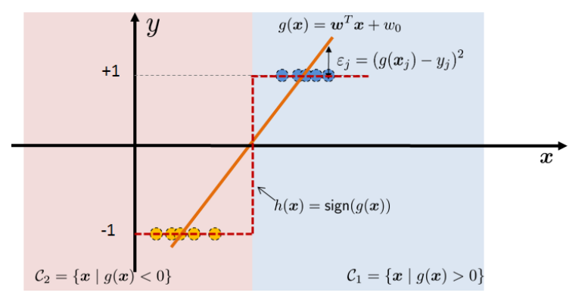
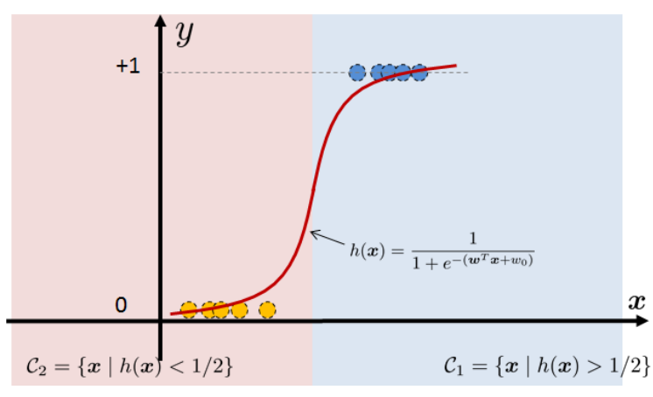
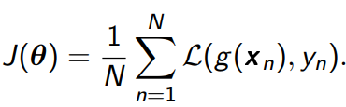
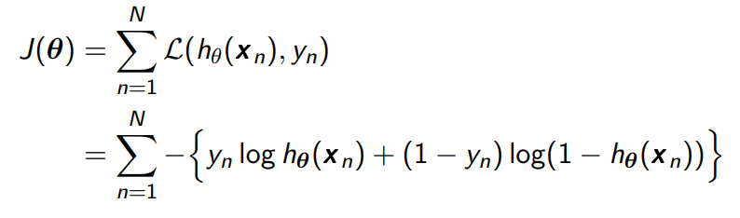
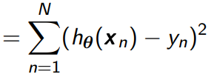
From Linear to Logistic Regression
Geometry of Linear Regression
Geometry of Logistic Regression
soft-version

Slide 4
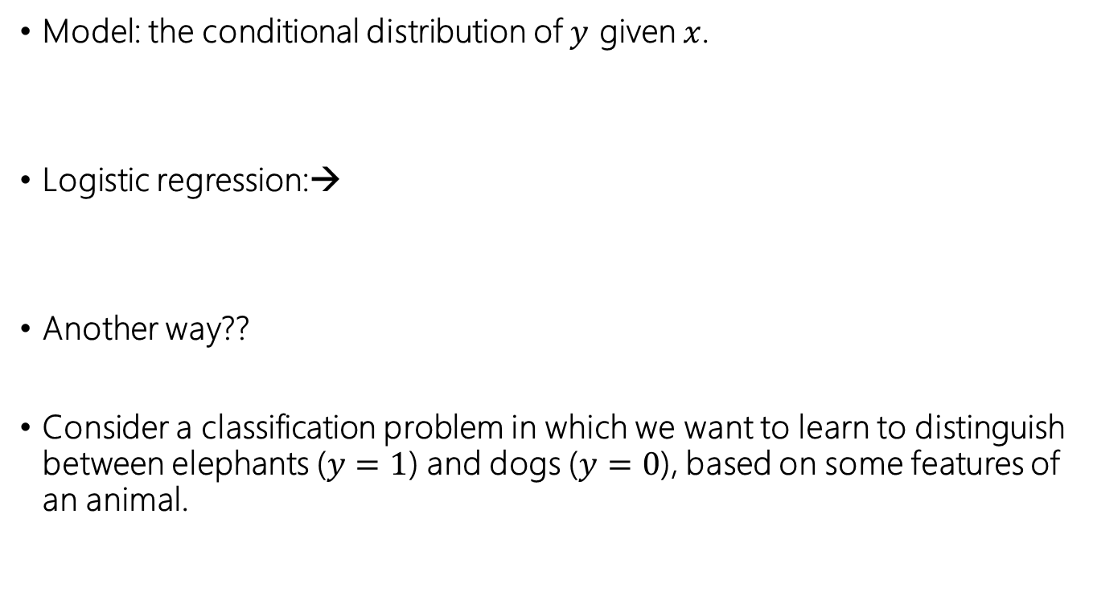
Classification
Model: the conditional distribution of $y$ given $x$.
Logistic regression:→
Another way??
Consider a classification problem in which we want to learn to distinguish between elephants ($y=1$) and dogs ($y=0$), based on some features of an animal.

Slide 5
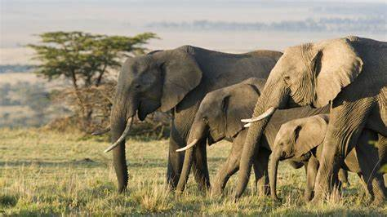


Classification
Here's a different approach.
First, looking at elephants, we can build a model of
what elephants look like.
Then, looking at dogs, we can build a separate
model of what dogs look like.
Finally, to classify a new animal, we can match the new animal against the elephant model, and match it against the dog model, to see whether the new animal looks more like the elephants or more like the dogs we had seen in the training set.

Slide 6

Generative Learning algorithms
Discriminative learning algorithms.
learn directly
learn mappings directly from the space of inputs $x$ to the labels $\left\{0，1\right\}$
Generative learning algorithms
Model： and
models the distribution of dogs‘ features,
models the distribution of elephants' features.
Notes:
知其然，也知其所以然

Slide 7
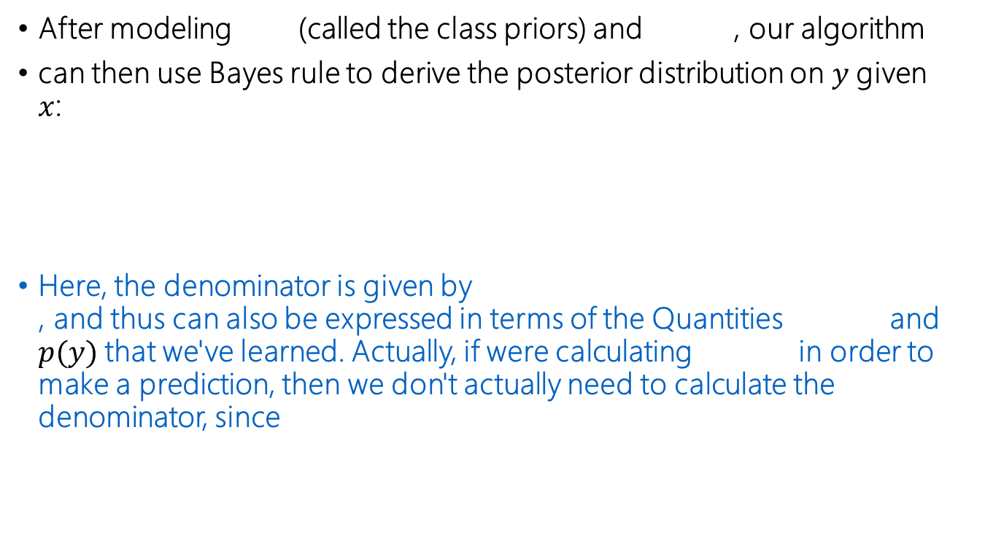
Generative Learning algorithms
After modeling (called the class priors) and , our algorithm
can then use Bayes rule to derive the posterior distribution on $y$given $x$:
Here, the denominator is given by , and thus can also be expressed in terms of the Quantities and $p(y)$that we've learned. Actually, if were calculating in order to make a prediction, then we don't actually need to calculate the denominator, since

Slide 8
Gaussian discriminant analysis
The first generative learning algorithm that we'll look at is Gaussian discriminant analysis (GDA).
In this model, we'll assume that is distributed according to a multivariate normal distribution. Lets talk briefly about the properties of multivariate normal distributions before moving on to the GDA model itself.

Slide 9
Multivariate normal distribution 多元正态分布
The multivariate normal distribution in n-dimensions, also called the multivariate Gaussian distribution, is parameterized by a
mean vector
and a covariance matrix .where is symmetric and positive semi-definite. Also written its density is given by:
The covariance of a vector-valued random variable Z

Slide 10
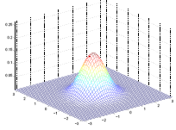
Some examples of Gaussian distribution
standard normal distribution

Slide 11
Some examples of Gaussian distribution

Slide 12
Some examples of Gaussian distribution
As becomes larger, the Gaussian becomes more “spread-out,“ and as it becomes smaller, the distribution becomes more “compressed."

Slide 13
Some examples of Gaussian distribution
The figures above show Gaussians with mean 0, and with covariance matrices respectively

Slide 14
Some examples of Gaussian distribution
We see that as we increase the o-diagonal entry in , the density becomes more “compressed" towards the 45 line (given by x1 = x2). We can see this more clearly when we look at the contours of the same three densities:

Slide 15
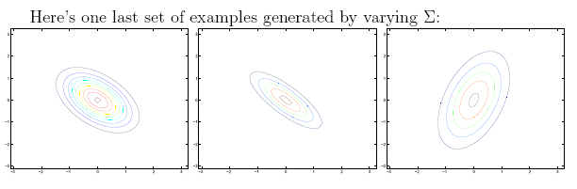
Some examples of Gaussian distribution
The plots above used, respectively,
From the leftmost and middle figures, we see that by decreasing the diagonal elements of the covariance matrix, the density now becomes “compressed“ again, but in the opposite direction. Lastly, as we vary the parameters, more generally the contours will form ellipses

Slide 16
Some examples of Gaussian distribution
As our last set of examples, fixing , by varying , we can also move the mean of the density around.
The figures above were generated using , and respectively

Slide 17
Gaussian Discriminant Analysis model
classification problem: continuous-valued random variables as input.
use GDA model, which models using a multivariate normal distribution. The model is:
Writing out the distributions, this is:

Slide 18
Gaussian Discriminant Analysis model
The log-likelihood of the data is given by
By maximizing function l with respect to the parameters, we find the maximum likelihood estimate of the parameters to be:

Slide 19
Gaussian Discriminant Analysis model
By maximizing function l with respect to the parameters, we find the maximum likelihood estimate of the parameters to be:

Slide 20
Gaussian Discriminant Analysis model
Pictorially, what the algorithm is doing can be seen in as follows:
Note that the two Gaussians have contours that are the same shape and orientation

Slide 21
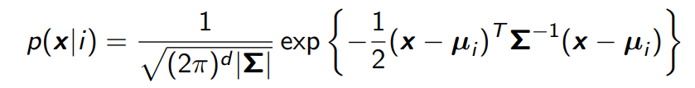

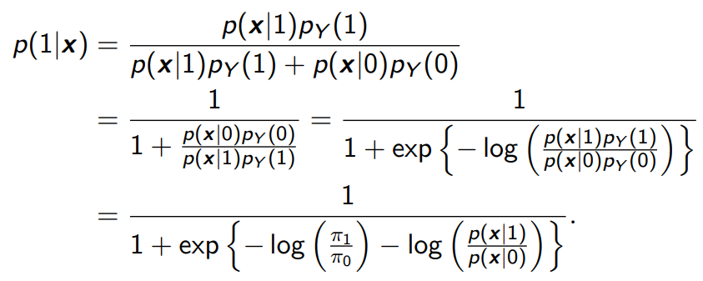
GDA VS. logistic regression
The likelihood is
The prior is
The prior is

Slide 22
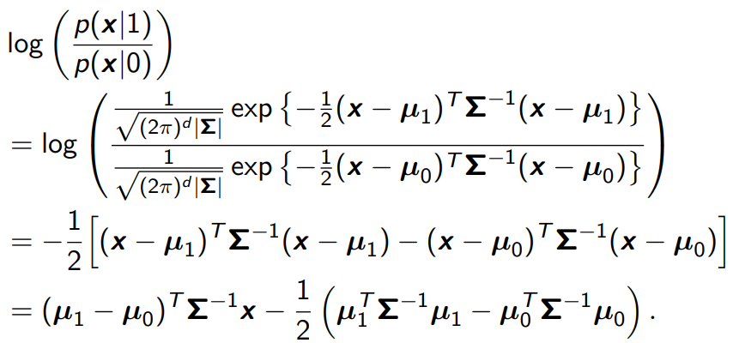
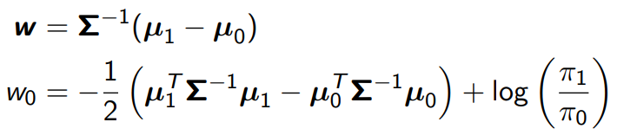
GDA VS. logistic regression
We can show that the last term is
Let us define

Slide 23
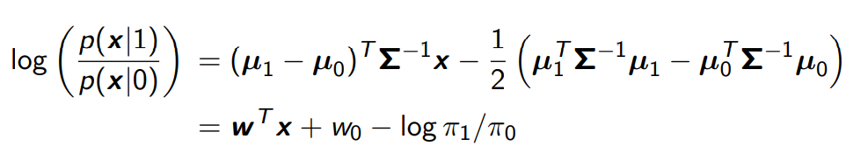
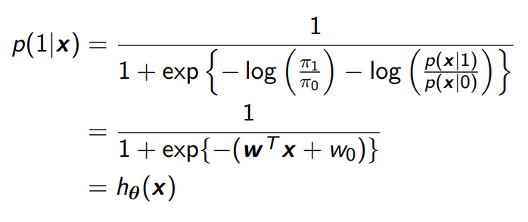
GDA VS. logistic regression
Then,
Therefore,

Slide 24
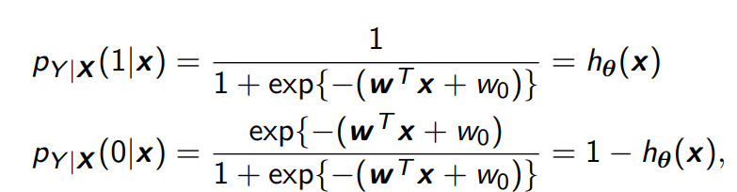
GDA VS. logistic regression
The hypothesis function is the posterior distribution
So logistic regression offers probabilistic reasoning which linear regression does not.
Not true when the covariances are different

Slide 25

GDA VS. logistic regression
? ?? When would we prefer one model over another?
GDA and logistic regression will, in general, give different decision boundaries when trained on the same dataset. Which is better?
is multivariate gaussian
(with shared )
follows a logistic function
This shows that GDA makes stronger modeling assumptions about the data than does logistic regression.

Slide 26
GDA VS. logistic regression
In contrast, by making significantly weaker assumptions, logistic regression is also more robust and less sensitive to incorrect modeling assumptions.
There are many different sets of assumptions that would lead to taking the form of a logistic function.
Logistic regression will also work well on Poisson data like this. But if we were to use GDA on such data---and fit Gaussian distributions to such non-Gaussian data---then the results will be less predictable, and GDA may (or may not) do well.

Slide 27
GDA VS. logistic regression
GDA makes stronger modeling assumptions, and is more data efficient (i.e., requires less training data to learn “well”) when the modeling assumptions are correct or at least approximately correct. Logistic regression makes weaker assumptions, and is significantly more robust to deviations from modeling assumptions.
Specifically, when the data is indeed non-Gaussian, then in the limit of large datasets, logistic regression will almost always do better than GDA.
For this reason, in practice logistic regression is used more often than GDA. (Some related considerations about discriminative vs. generative models also apply for the Naive Bayes algorithm that we discuss next, but the Naive Bayes algorithm is still considered a very good, and is certainly also a very popular, classification algorithm.)

Slide 28
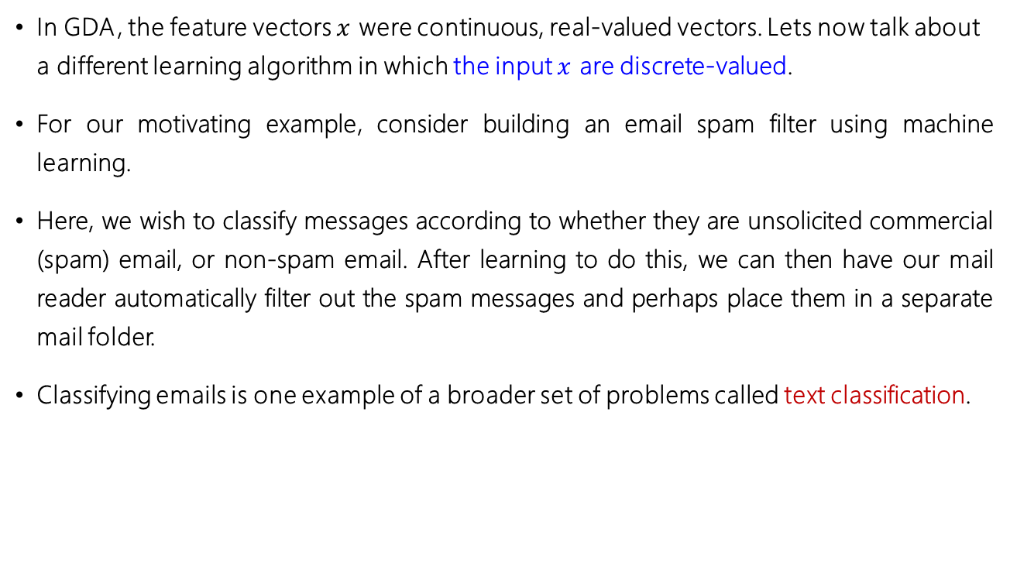
Discussions:
In GDA, the feature vectors $x$ were continuous, real-valued vectors. Lets now talk about a different learning algorithm in which the input $x$ are discrete-valued.
For our motivating example, consider building an email spam filter using machine learning.
Here, we wish to classify messages according to whether they are unsolicited commercial (spam) email, or non-spam email. After learning to do this, we can then have our mail reader automatically filter out the spam messages and perhaps place them in a separate mail folder.
Classifying emails is one example of a broader set of problems called text classification.

Slide 29
Discussions:
Lets say we have a training set (a set of emails labeled as spam or non-spam). We'll begin our construction of our spam filter by specifying the features used to represent an email.
We will represent an email via a feature vector whose length is equal to the number of words in the dictionary.
Specifically, if an email contains the i-th word of the dictionary, then we will set.
otherwise,
One-hot 编码
is used to represent an email that contains the words “a” and “buy”, but not “aardvark” , “aardwolf” or “zygmurgy”. The set of words encoded into the
feature vector is called the vocabulary, so the dimension of x is equal to the size of the vocabulary.

Slide 30
Discussions:
Having chosen our feature vector, we now want to build a discriminative
model.
Model:
But if we have a vocabulary of 50000 words, then (x is a 50000-dimensional vector of 0's and 1's),
and if we were to model x explicitly with a multinomial distribution over
the possible outcomes, then we'd end up with a ( )-dimensional parameter vector. This is clearly too many parameters.

Slide 31
Naive Bayes
Naive Bayes (NB) assumption
assume that the are conditionally independent given y
Naive Bayes classier
if y = 1 means spam email; “buy” is word 2087 and “price” is word 39831;
Note that this is not the same as saying that and are independent

Slide 32
Naive Bayes
The first equality simply follows from the usual properties of mprobabilities,
and the second equality used the NB assumption. We note that even though the Naive Bayes assumption is an extremely strong assumptions, the resulting algorithm works well on many problems.

Slide 33
Naive Bayes
Our model is parameterized by
and
As usual, given a training set
we can write down the joint likelihood of the data:
Maximizing this with respect to gives the maximum likelihood estimates:

Slide 34
Naive Bayes
Having t all these parameters, to make a prediction on a new example with features x, we then simply calculate
and pick whichever class has the higher posterior probability

Slide 35
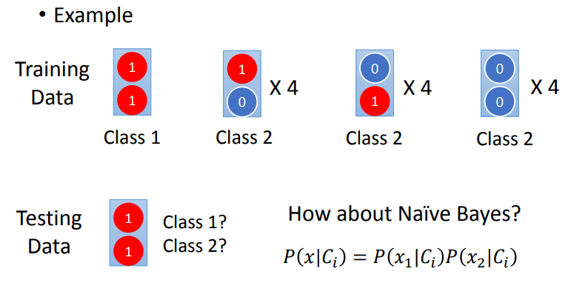
Generative v.s. Discriminative

Slide 36
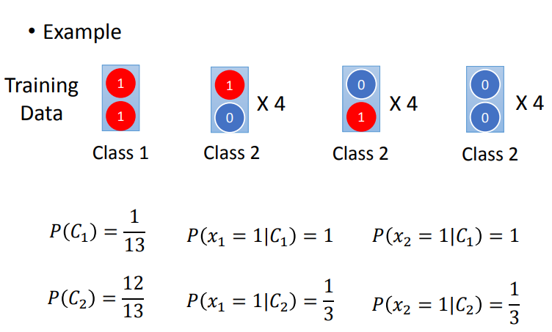
Generative v.s. Discriminative

Slide 37
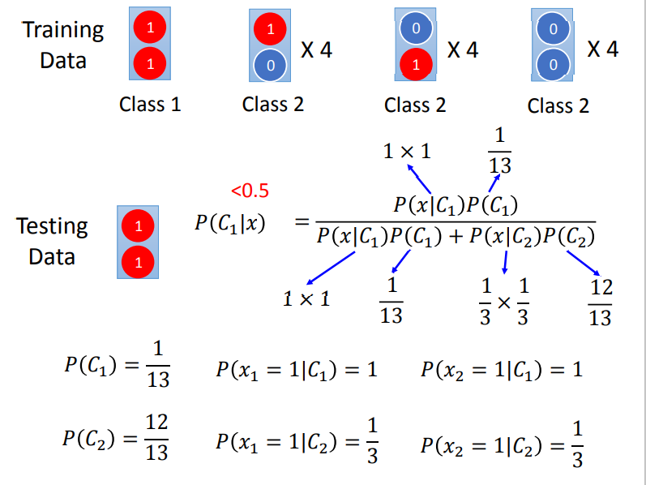
Generative v.s. Discriminative

Slide 38
Naive Bayes
Here, we would simply model as multinomial rather than as Bernoulli.
Indeed, even if some original input attribute (say, the living area of a house, as in our earlier example) were continuous valued, it is quite common to discretize it---that is, turn it into a small set of discrete values---and apply Naive Bayes. For instance, if we use some feature to represent living area, we might discretize the continuous values as follows:

Slide 39
Naive Bayes
Living area (sq. feet) | <400 | 400-800 | 800-1200 | 1200-1600 | >1600
 | 1 | 2 | 3 | 4 | 5
890
We can then apply the Naive Bayes algorithm, and model with a multinomial distribution, as described previously.
When the original, continuous-valued attributes are not well-modeled by a multivariate normal distribution, discretizing the features and
using Naive Bayes (instead of GDA) will often result in a better classier.

Slide 40
Laplace smoothing
The Naive Bayes algorithm will work fairly well for many problems, but there is a simple change that makes it work much better, especially for text classification.
Example：
NerIPS conference.
Assuming that “NerIPS” was the 35000th word in the dictionary

Slide 41
Laplace smoothing
because it has never seen “nips” before in either spam or non-spam training examples, it thinks the probability of seeing it in either type of email is zero. Hence, when trying to decide if one of these messages containing “nerips” is spam, it calculates the class posterior probabilities, and obtains
how to make a prediction?

Slide 42
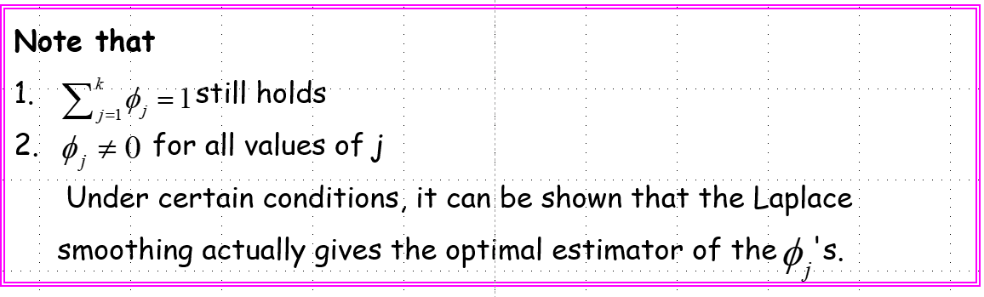
Laplace smoothing
Laplace smoothing:

Slide 43
Laplace smoothing
Returning to our Naive Bayes classier, with Laplace smoothing, we therefore obtain the following estimates of the parameters:

